Slide 1
Chapter 3 Transport Layer
TCP - Error Control &
Congestion Control

Slide 2
15-8 ERROR CONTROL
Error control in TCP is achieved through the use of three tools:
checksum
acknowledgment
time-out
TCP/IP Protocol Suite
‹#›
Notes:
‹#›

Slide 3
Topics Discussed in the Section
Checksum
Acknowledgment
Retransmission
Out-of-Order Segments
TCP/IP Protocol Suite
‹#›
Notes:
‹#›

Slide 4

Note
ACK segments do not consume sequence numbers and
are not acknowledged.
TCP/IP Protocol Suite
‹#›
Notes:
‹#›

Slide 5
Acknowledgement Type
In the past, TCP used only one type of acknowledgement: Accumulative Acknowledgement (ACK), also namely accumulative positive acknowledgement
More and more implementations are adding another type of acknowledgement: Selective Acknowledgement (SACK), SACK is implemented as an option at the end of the TCP header.

Slide 6
Note
Data may arrive out of order and be temporarily stored by the receiving TCP,
but TCP guarantees that no out-of-order data are delivered to the process.
TCP/IP Protocol Suite
‹#›
Notes:
‹#›

Slide 7
Note
TCP can be best modeled as a Selective Repeat protocol.
TCP/IP Protocol Suite
‹#›
Notes:
‹#›

Slide 8
Rules for Generating ACK (1)
1. When one end sends a data segment to the other end, it must include an ACK. That gives the next sequence number it expects to receive.
2. The receiver needs to delay sending (until another segment arrives or 500ms) an ACK segment if there is only one outstanding in-order segment. It prevents ACK segments from creating extra traffic.
3. There should not be more than 2 in-order unacknowledged segments at any time. It prevent the unnecessary retransmission.

Slide 9
Rules for Generating ACK (2)
4. When a segment arrives with an out-of-order sequence number that is higher than expected, the receiver immediately sends an ACK segment announcing the sequence number of the next expected segment. (for fast retransmission)
5. When a missing segment arrives, the receiver sends an ACK segment to announce the next sequence number expected.
6. If a duplicate segment arrives, the receiver immediately sends an ACK.

Slide 10
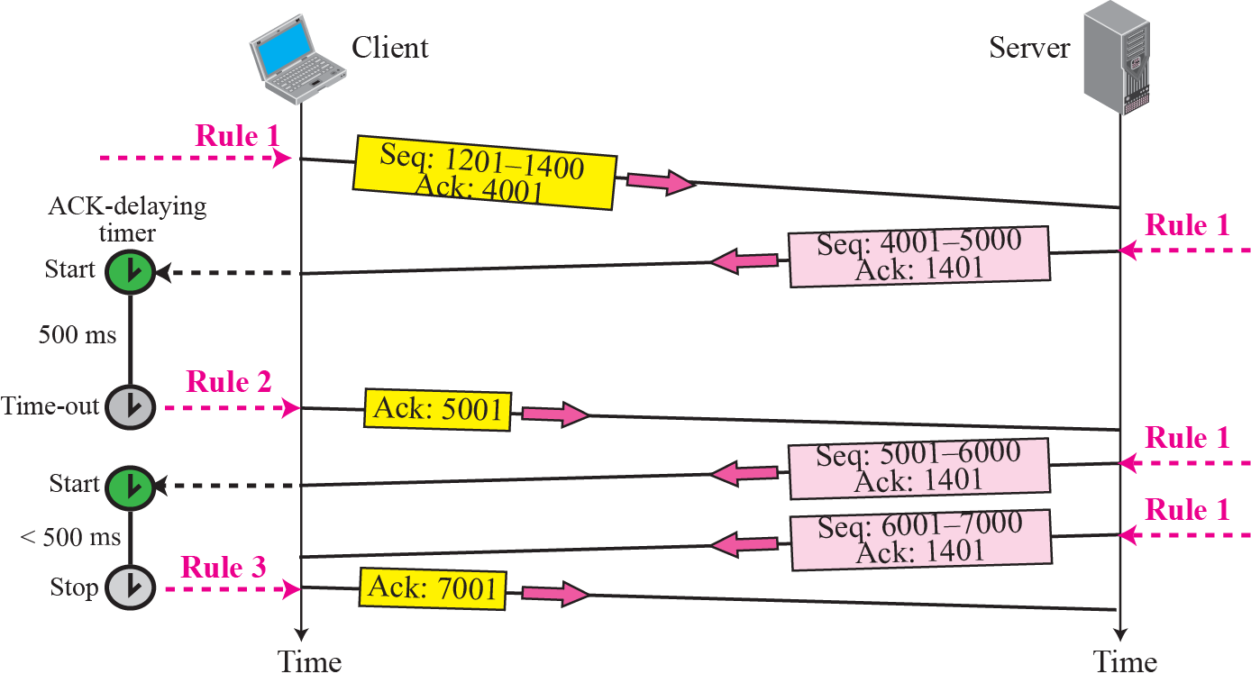
Figure 15.29 Normal operation
TCP/IP Protocol Suite
‹#›
Notes:
‹#›

Slide 11
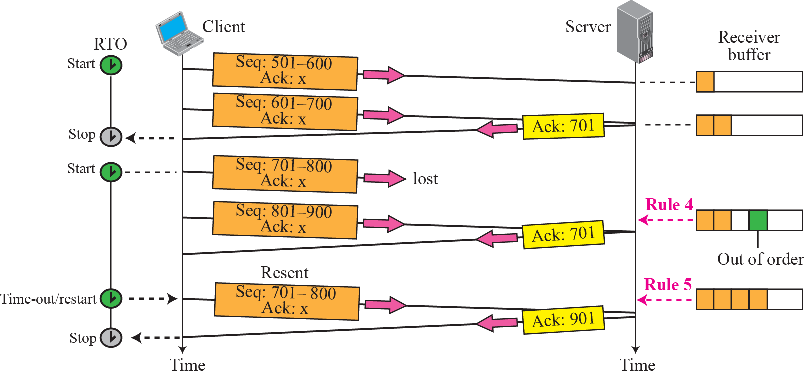
Figure 15.30 Lost segment
TCP/IP Protocol Suite
‹#›
Notes:
‹#›

Slide 12
Note
The receiver TCP delivers only ordered data to the process.
TCP/IP Protocol Suite
‹#›
Notes:
‹#›

Slide 13
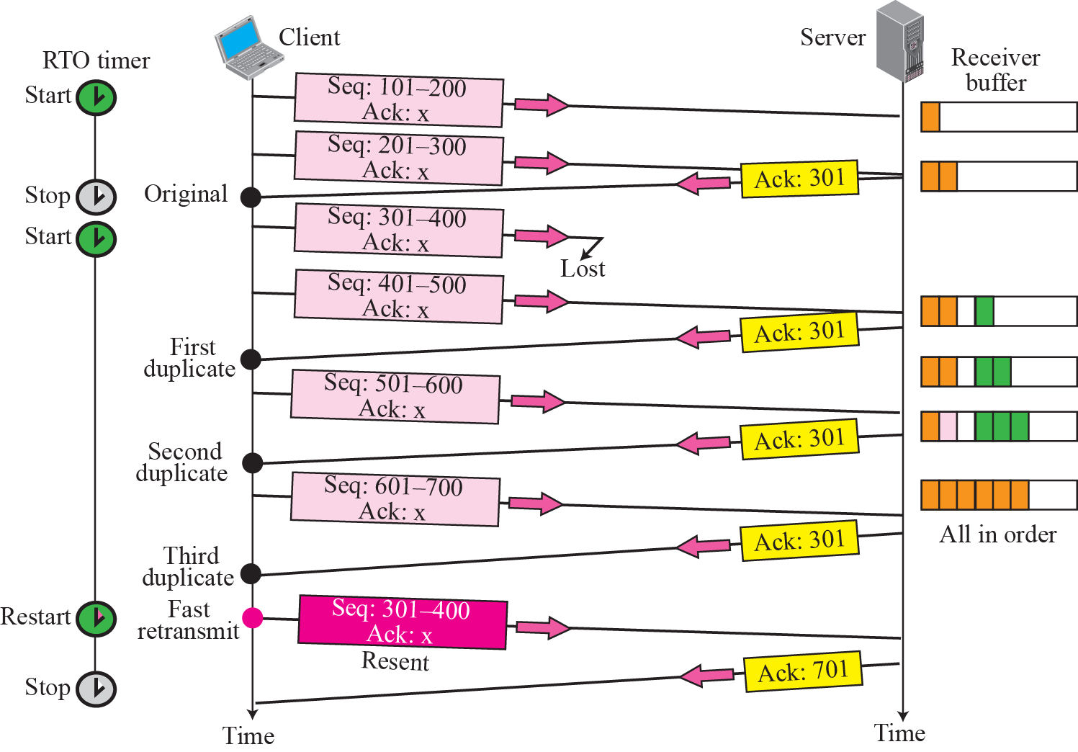





Figure 15.31 Fast retransmission
TCP/IP Protocol Suite
‹#›
Notes:
‹#›

Slide 14
Fast Retransmit
Time-out period often relatively long:
long delay before resending lost packet
Detect lost segments via duplicate ACKs.
Sender often sends many segments back-to-back
If segment is lost, there will likely be many duplicate ACKs.
If sender receives 3 ACKs for the same data, it supposes that segment after ACKed data was lost:
fast retransmit: resend segment before timer expires

Slide 15
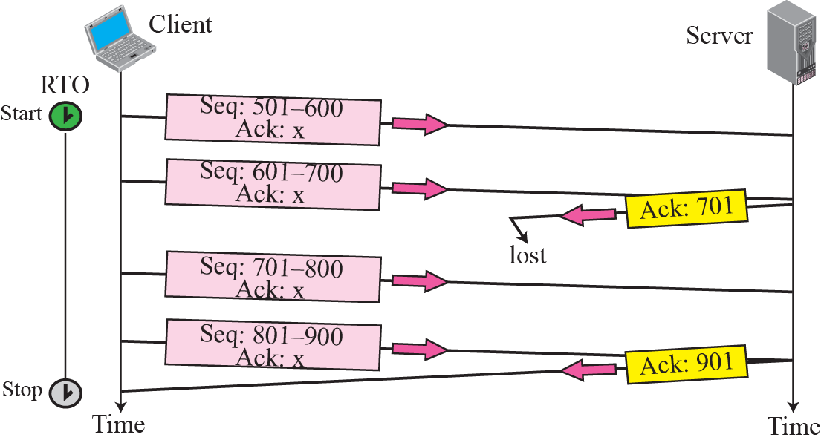
Figure 15.32 Lost acknowledgment
TCP/IP Protocol Suite
‹#›
Notes:
‹#›

Slide 16
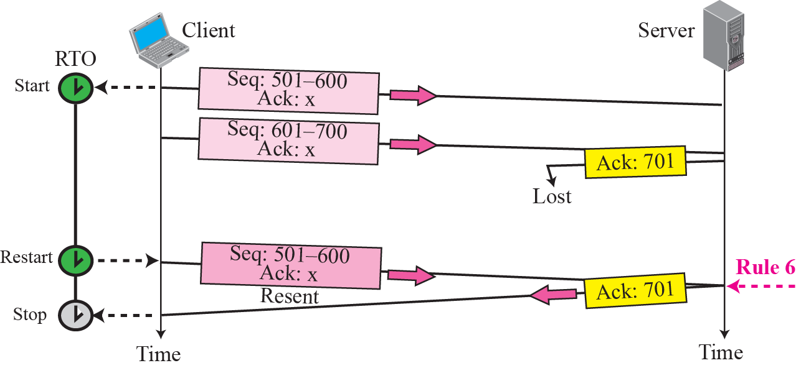
Figure 15.33 Lost acknowledgment corrected by resending a segment
TCP/IP Protocol Suite
‹#›
Notes:
‹#›

Slide 17
Note
Lost acknowledgments may create deadlock if they are not
properly handled.
TCP/IP Protocol Suite
‹#›
Notes:
‹#›

Slide 18
15-9 CONGESTION CONTROL
TCP uses
1. congestion window and
2. congestion policy
to avoid congestion and detect and alleviate congestion after it has occurred.
TCP/IP Protocol Suite
‹#›
Notes:
‹#›

Slide 19
Topics Discussed in the Section
Congestion Window
Congestion Policy
TCP/IP Protocol Suite
‹#›
Notes:
‹#›

Slide 20
Congestion
Informally: “too many sources sending too much data too fast for network to handle”
Appears if the load on the network is greater than the capacity of the network
load: the number of packets sent to the network
capacity: the number of packets a network can handle
manifestations:
buffer overflow at routers
queuing in router buffers

Slide 21
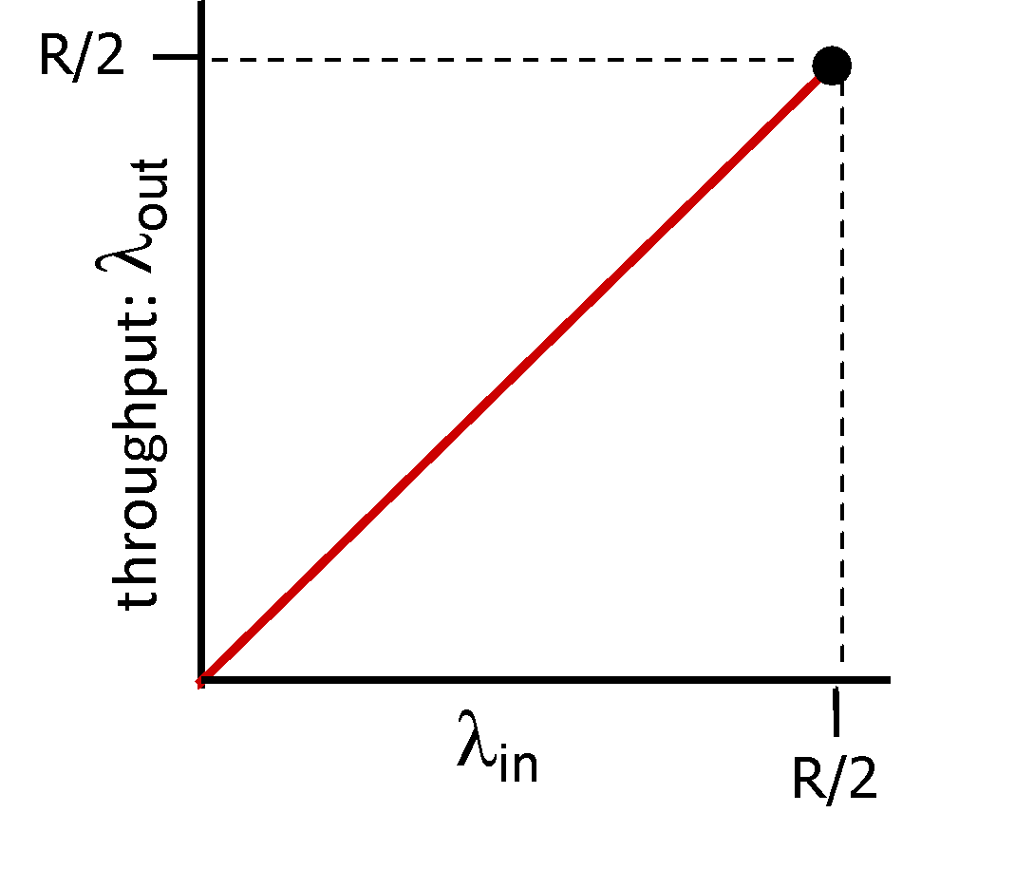
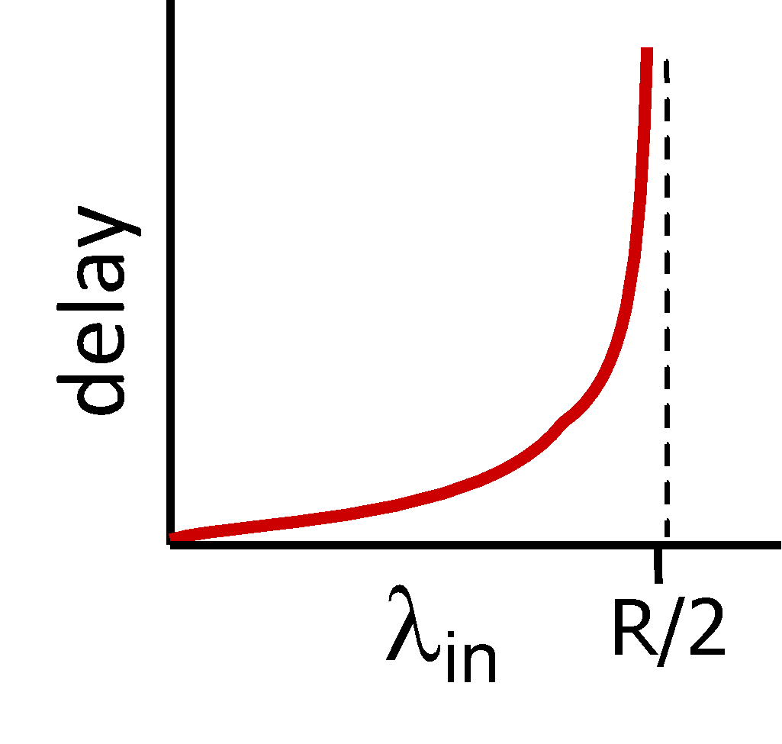
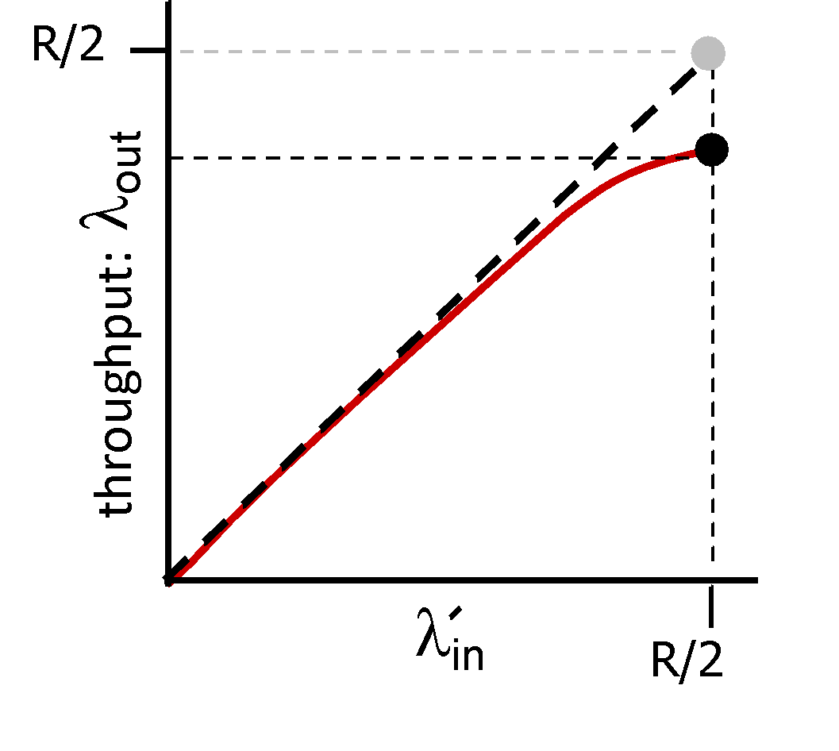
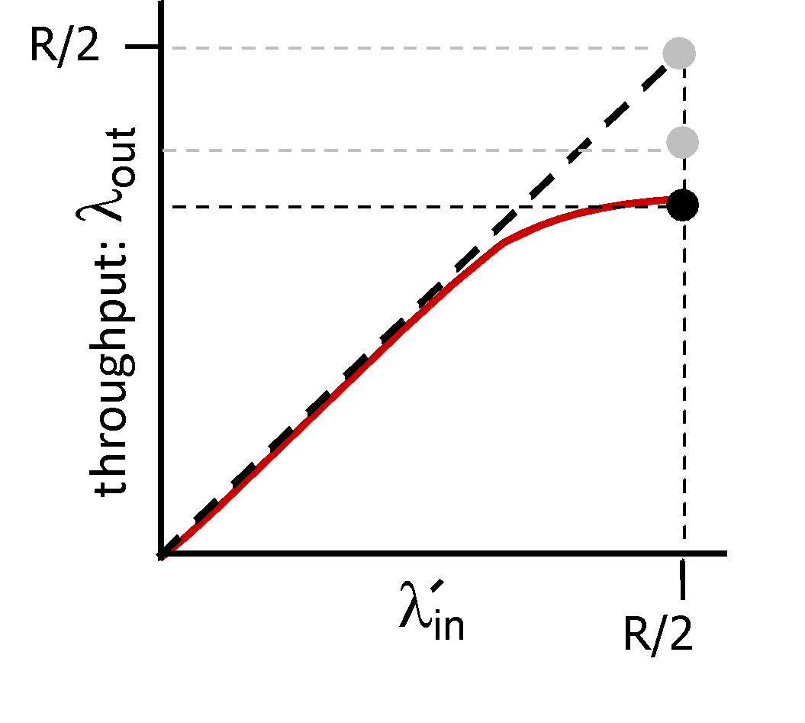
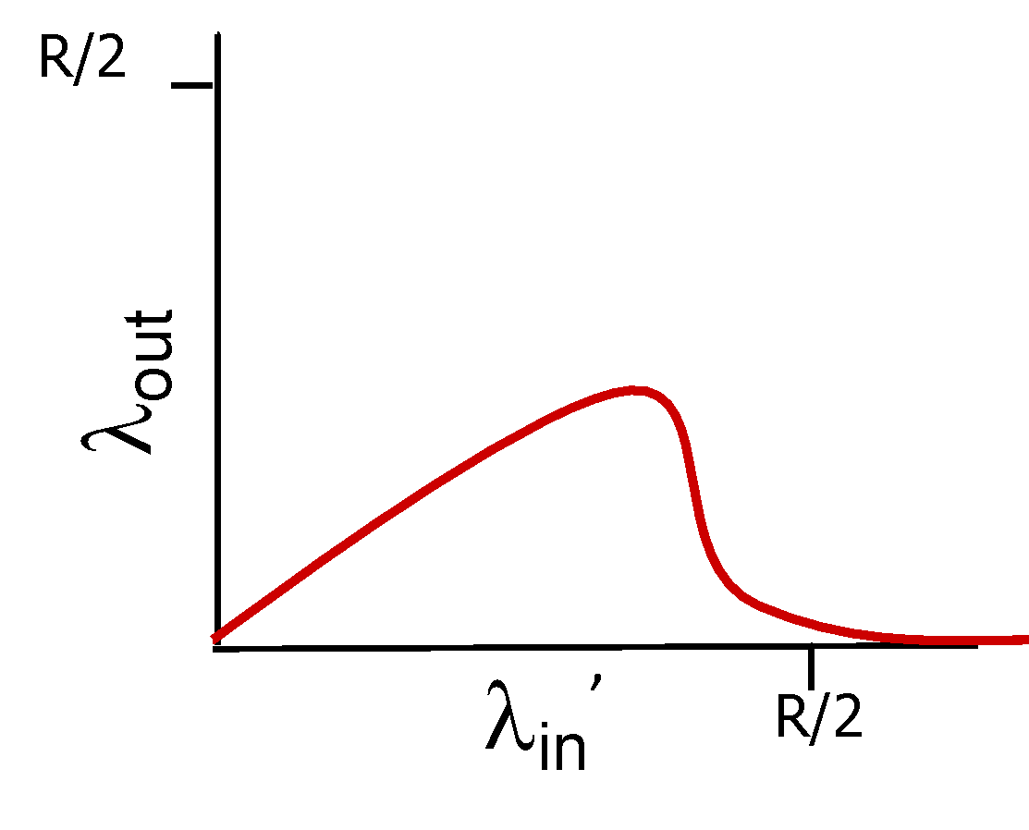
Causes/costs of congestion: insights
throughput can never exceed capacity
delay increases as capacity approached
loss/retransmission decreases effective throughput
un-needed duplicates further decreases effective throughput
upstream transmission capacity / buffering wasted for packets lost downstream

Slide 22

Approaches towards congestion control
End-end congestion control:
no explicit feedback from network
congestion inferred from observed loss, delay
ACKs
data
data
ACKs
approach taken by TCP

Slide 23
Approaches towards congestion control
Network-assisted congestion control:
routers provide direct feedback to sending/receiving hosts with flows passing through congested router
may indicate congestion level or explicitly set sending rate
explicit congestion info
ACKs
data
data
ACKs
TCP ECN, ATM, DECbit protocols

Slide 24
TCP Congestion Control
How does sender perceive congestion?
loss event = timeout or 3 duplicate acks
Retransmission of the lost packets does not solve congestion problem – it aggravates it
In flow control, sender window size determined by the receiver window – no information about the network congestion
TCP sender
Maintains congestion window CongWin
dynamic function of perceived network congestion
Limits sender window to min (receiver window size, congestion window size)
LastByteSent-LastByteAcked ≤ min{CongWin,RcvWindow}

Slide 25
TCP Congestion Control
What is the size of CongWin?
three mechanisms:
Slow Start
Additive increase (AI)
Multiplicative Decrease (MD)

Slide 26
TCP congestion control: AIMD
approach: senders can increase sending rate until packet loss (congestion) occurs, then decrease sending rate on loss event
Additive Increase
Multiplicative Decrease
increase sending rate by 1 maximum segment size every RTT until loss detected
cut sending rate in half at each loss event
AIMD sawtooth
behavior: probing
for bandwidth
TCP sender Sending rate
time

Slide 27
TCP Slow Start
When connection begins, CongWin = 1 MSS
Example: MSS = 500 bytes & RTT = 200 msec
initial rate = 20 kbps
available bandwidth may be >> MSS/RTT
It is desirable to quickly ramp up to respectable rate
When connection begins
increase rate exponentially fast until
first loss event
or reaches a threshold (then additive increase)
MSS = Maximum Segment Size

Slide 28
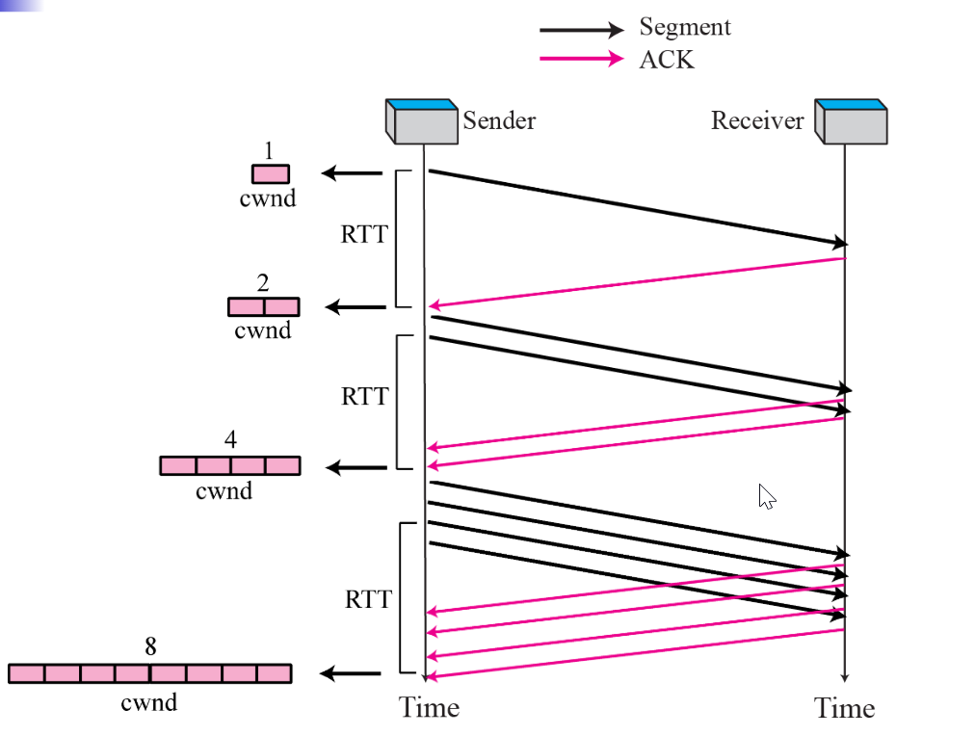
TCP Slow Start
done by incrementing
CongWin for every
ACK received
Summary: initial rate is slow
but ramps up exponentially fast

Slide 29
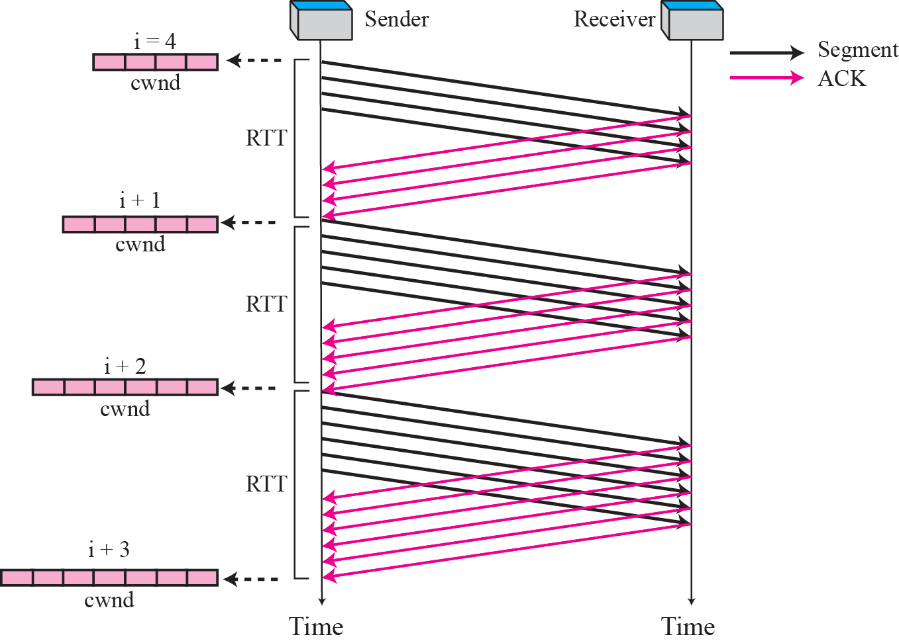
Additive Increase
for each successfully received ACK, increase the window size by ((1/n) * MSS)).
n = current CongWin size
In other word, increase 1 MSS after each RTT.

Slide 30
Multiplicative Decrease
after loss event reduce or cut CongWin to
half of previous value
Or any specific value

Slide 31
Congestion control in TCP
Slow Start (SS) (Exponential Increase)
start with the congestion window (CongWin) = 1MSS
for each successfully received ACK increase the cwnd size by 1 until the CongWin = threshold value;
Additive Increase (AI) (Congestion Avoidance)
after that, for each successfully received ACK, increase the window size by 1/n segments up to a size of the receiver window. n=current CongWin size
Multiplicative Decrease (MD)
if a time-out occurs the (TCP Tahoe, TCP Reno)
Threshold = ½ (CongWin), CongWin = 1 MSS, .
if 3 duplicated ACKs received (TCP Reno)
Threshold = ½ (CongWin), CongWin = threshold

Slide 32
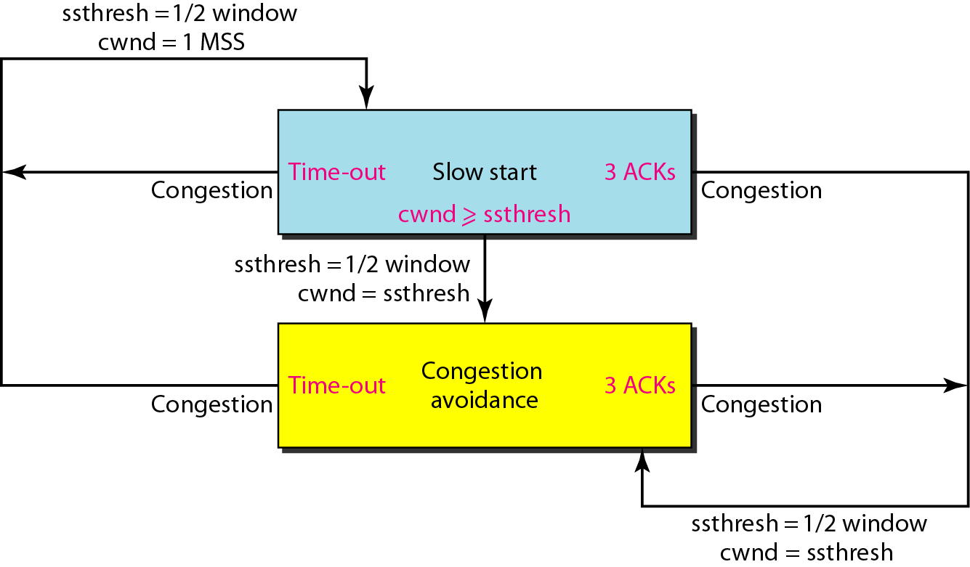
Congestion control in TCP

Slide 33
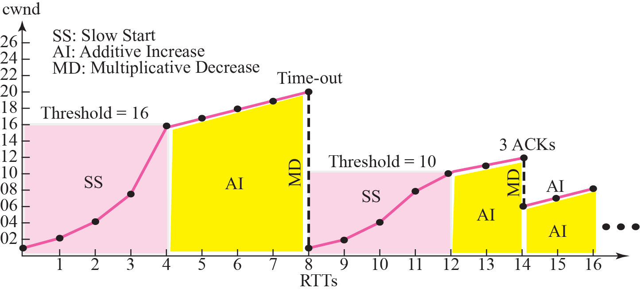
Congestion control in TCP

Slide 34
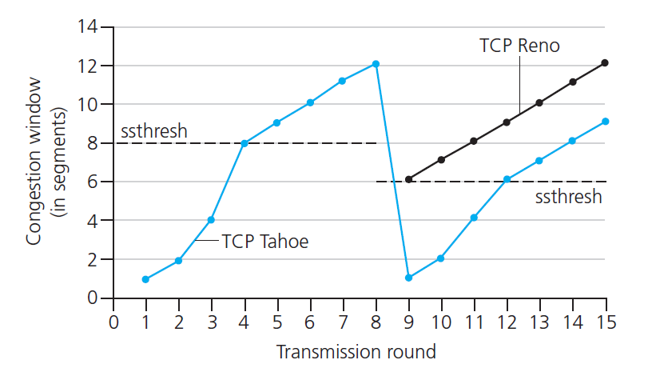
TCP: Switching from Slow Start to Additive Increase
Q: when should the exponential increase switch to linear?
A: when cwnd gets to 1/2 of its value before timeout.
Implementation:
variable ssthresh
on loss event, ssthresh is set to 1/2 of cwnd just before loss event

Slide 35
TCP CUBIC
Is there a better way than AIMD to “probe” for usable bandwidth?
Insight/intuition:
W_{max}: sending rate at which congestion loss was detected
congestion state of bottleneck link probably (?) hasn’t changed much
after cutting rate/window in half on loss, initially ramp to to W_{max} faster, but then approach W_{max} more slowly
W_{max}
classic TCP
TCP CUBIC - higher throughput in this example
W_{max}/2

Slide 36
TCP CUBIC
K: point in time when TCP window size will reach W_{max}
K itself is tunable
increase W as a function of the cube of the distance between current time and K
larger increases when further away from K
smaller increases (cautious) when nearer K
TCP CUBIC default in Linux, most popular TCP for popular Web servers
W_{max}
TCP Reno
TCP CUBIC
TCP
sending
rate
time
t₀
t₁
t₂
t₃
t₄

Slide 37
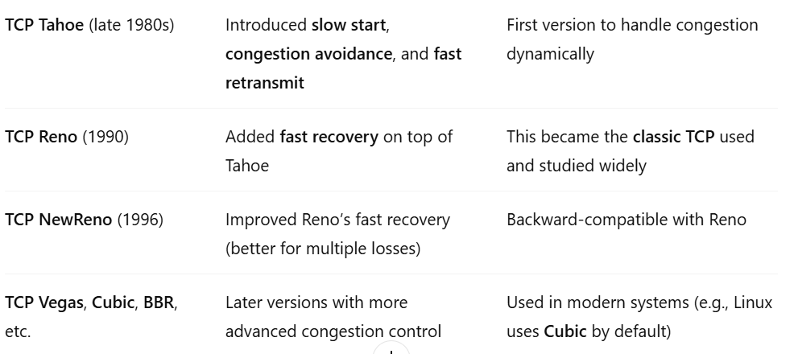
TCP Evolution Timeline

Slide 38
TCP fairness
Fairness goal: if K TCP sessions share same bottleneck link of bandwidth R, each should have average rate of R/K
TCP connection 1
bottleneck
router
capacity R
TCP connection 2

Slide 39
Q: is TCP Fair?
Example: two competing TCP sessions:
additive increase gives slope of 1, as throughout increases
multiplicative decrease decreases throughput proportionally
R
equal bandwidth share
Is TCP fair?
A: Yes, under idealized assumptions:
same RTT
fixed number of sessions only in congestion avoidance
loss: decrease window by factor of 2
congestion avoidance: additive increase
Connection 2 throughput
loss: decrease window by factor of 2
congestion avoidance: additive increase
Connection 1 throughput
R

Slide 40
Fairness: must all network apps be “fair”?
Fairness and UDP
multimedia apps often do not use TCP
do not want rate throttled by congestion control
instead use UDP:
send audio/video at constant rate, tolerate packet loss
there is no “Internet police” policing use of congestion control
Fairness, parallel TCP connections
application can open multiple parallel connections between two hosts
web browsers do this , e.g., link of rate R with 9 existing connections:
new app asks for 1 TCP, gets rate R/10
new app asks for 11 TCPs, gets R/2

